Slide 2
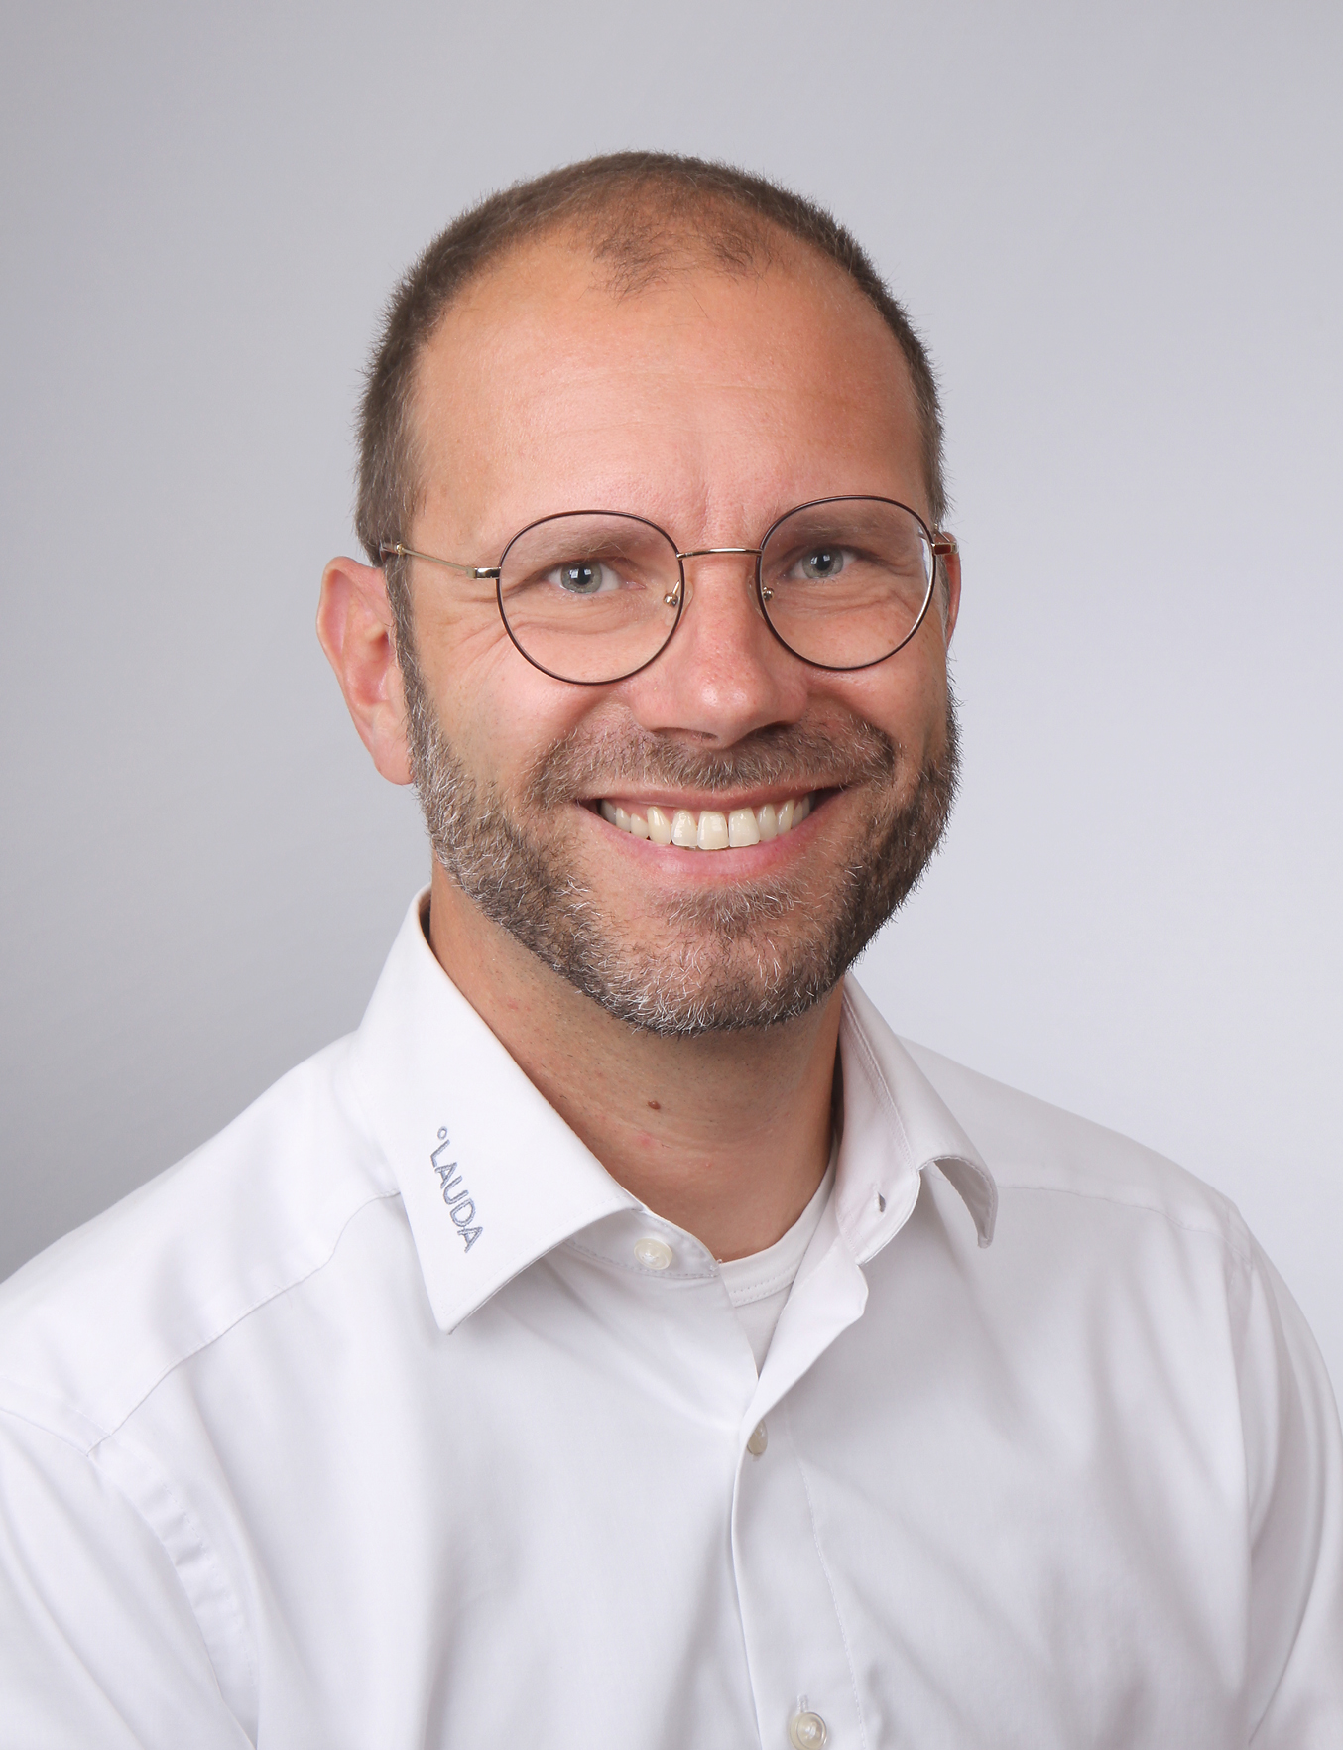

Marco Hauser
Managing Director
Degree LAUDA Precision Pvt. Ltd.
+91 8805230098
info@degree-lauda-precision.in
Sawant Process Solutions Pvt. Ltd.
T +91 22 40166407
info@sawantsolutions.com
www.sawantsolutions.com

Slide 3
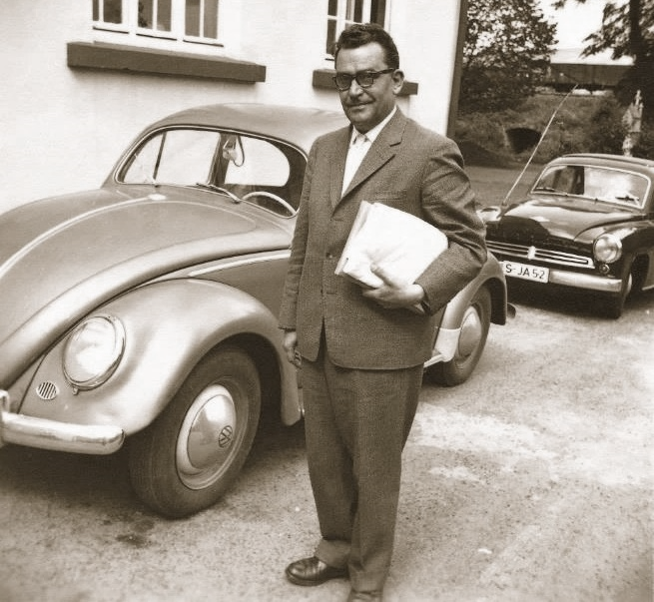

A vision of founding a company
PIONEER OF TEMPERATURE CONTROL TECHNOLOGY
In 1955, Dr. Rudolf Wobser decided to flee from East Germany to the West with his family. 1956, he founded the measuring instrument factory, Messgeräte-Werk LAUDA Dr. R. Wobser KG.
Notes:
A bid for freedom
Dr. Rudolf Wobser, a nonpartisan physicist in the GDR, started his career in 1936 as an employee of the chemist, Fritz Höppler. In 1955, Wobser became technical director and head engineer at VEB PrüfgeräteWerk Medingen in Dresden. As part of his work, he visited ACHEMA on the “capitalist outside”, as it was known in GDR jargon. For him, the visit was an inspiration, motivation and stimulus; he could feel the optimism, vibrancy and hustle and bustle of the free West. There, at ACHEMA in Frankfurt, he finally made the decision to leave East Germany so that he and his family could live a self-determined life. He wanted to finally realize his dream: his very own company, in which he could implement his ideas and designs according to his own vision. In 1955, the border between East and West Germany in Berlin was still heavily guarded, but open to commuters. In August 1955, Rudolf Wobser's son, Karlheinz, and his siblings, Gerhard and Christine, helped their mother cross the border. Then he went back one more time to help his father sell his car and his motorbike as starting capital for the family in the West. Then the two of them took the train towards West Berlin. At the last station before the border, the GDR border guards boarded the train and a crackly loudspeaker voice announced: “You are now leaving the democratic sector.”

Slide 4
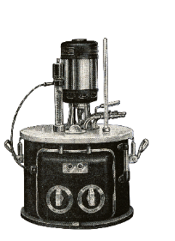
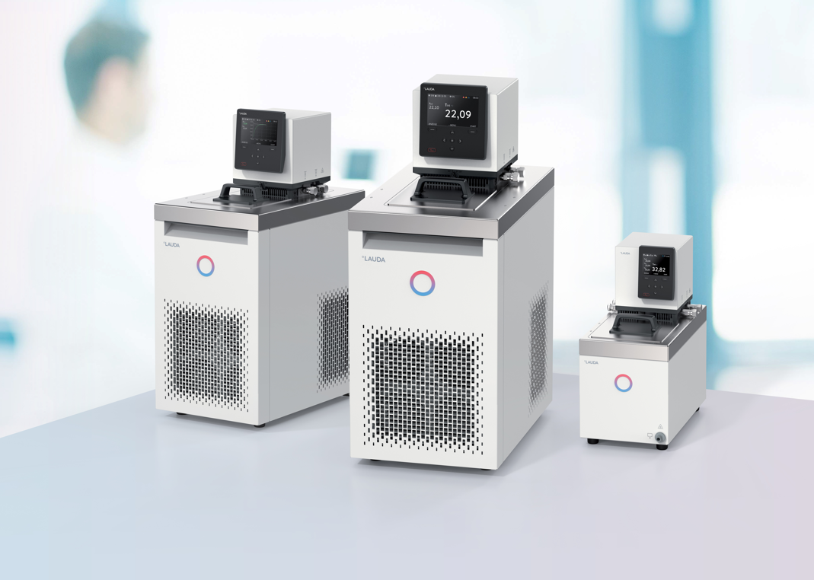
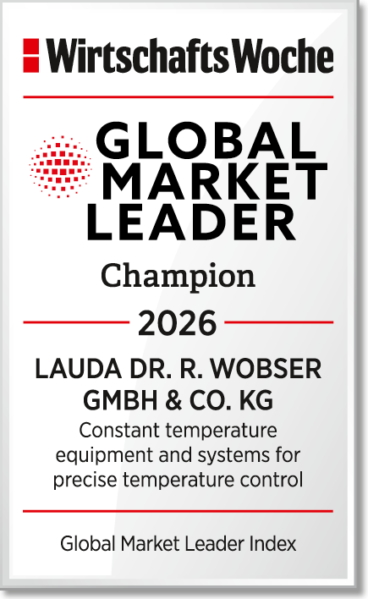
history of LAUDA Plant Engineering
1949 – Dr. Rudolf Wobser developed the first production-ready U8 thermostat .
TODAY – Global market leader for constant temperature equipment and systems.
Notes:
As early as the 15th century, alchemists recognized that temperature was important for the outcome of their experiments. They constructed ovens with the aim of reaching specific temperatures as accurately as possible.
400 years later, in 1876, Carl von Linde created the first compression refrigerating machine using ammonia, laying the foundation stone for modern refrigeration technology.
In 1932, Fritz Höppler designed a measuring instrument to measure viscosity. During his measurements, he realized that the results depend heavily on the temperature of the samples. He clad the measuring tube with a liquid sheath, which was temperature-controlled by a thermostat with an integrated pump. This was the first version of the classic circulation thermostat.
In 1956, “Messgeräte-Werk Lauda” was founded by Dr. Rudolf Wobser. The U8 thermostat and other milestones in constant temperature technology, all the way through to industrial heating and cooling systems, are manufactured. Today, German companies are world market leaders in the precise temperature control of devices and systems.

Slide 5
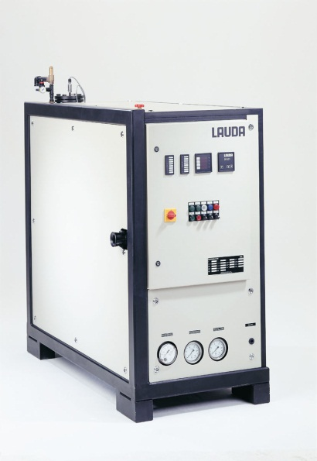
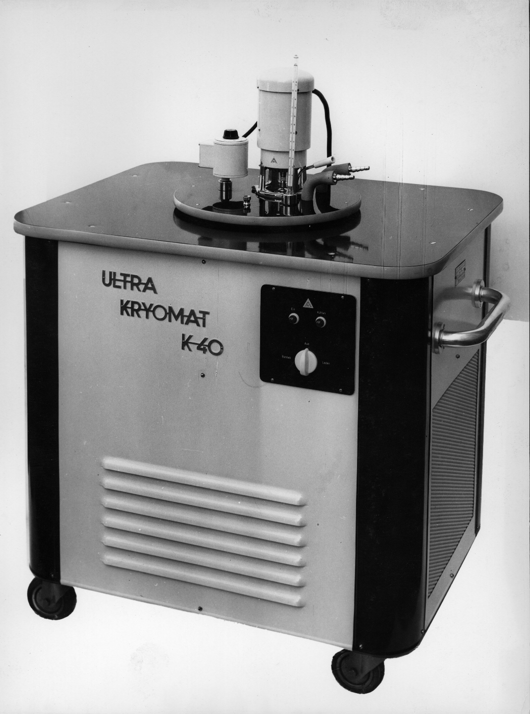
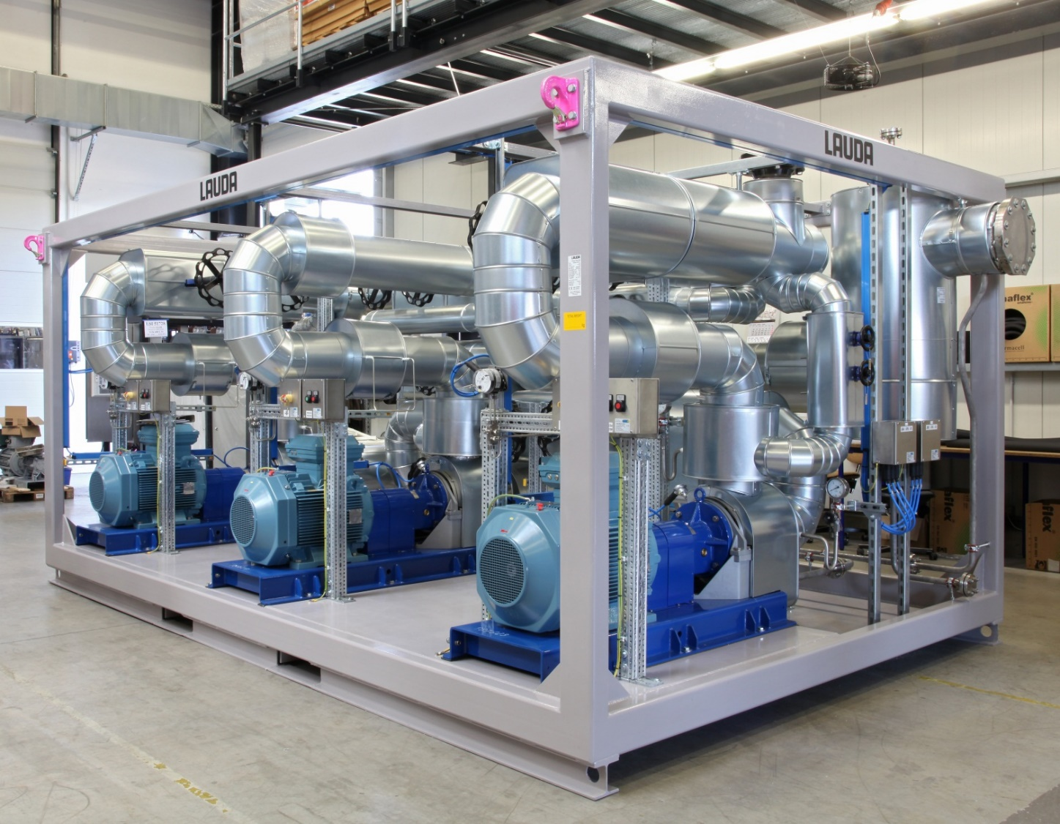
history of LAUDA Plant Engineering
1964 – First industrial heater. Start of LAUDA division Pant Engineering
1987 – First industrial chiller with PID controller
TODAY – PLC controlled Heating and Cooling skids. TCUs up to DN 250 – 400 kW - from -150 °C to 550°C
Notes:
As early as the 15th century, alchemists recognized that temperature was important for the outcome of their experiments. They constructed ovens with the aim of reaching specific temperatures as accurately as possible.
400 years later, in 1876, Carl von Linde created the first compression refrigerating machine using ammonia, laying the foundation stone for modern refrigeration technology.
In 1932, Fritz Höppler designed a measuring instrument to measure viscosity. During his measurements, he realized that the results depend heavily on the temperature of the samples. He clad the measuring tube with a liquid sheath, which was temperature-controlled by a thermostat with an integrated pump. This was the first version of the classic circulation thermostat.
In 1956, “Messgeräte-Werk Lauda” was founded by Dr. Rudolf Wobser. The U8 thermostat and other milestones in constant temperature technology, all the way through to industrial heating and cooling systems, are manufactured. Today, German companies are world market leaders in the precise temperature control of devices and systems.

Slide 6
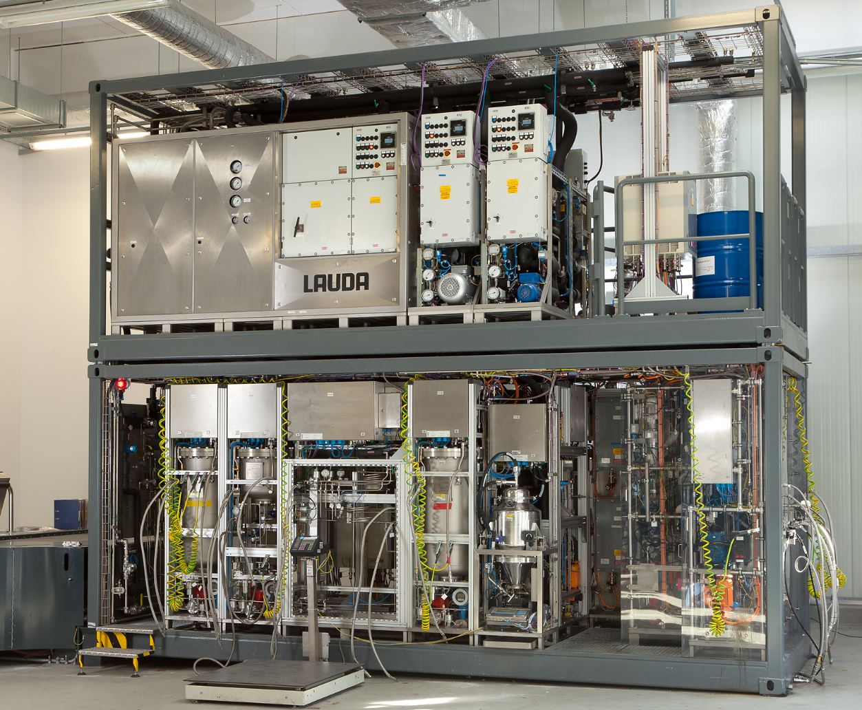
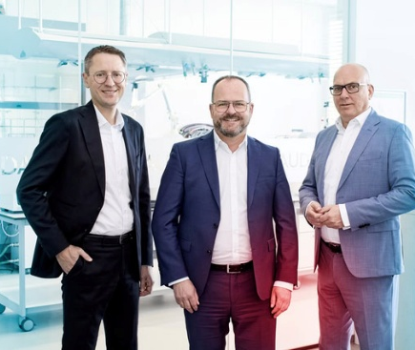
COMPANY today
TOTAL SALES
100 MILLION EURO
MANAGEMENT
LAUDA is a family-owned company. Long-term decisions and a high level of quality and environmental awareness are central elements of our management style.
EMPLOYEES
~570
Notes:
R&D, production and the LAUDA head office are located at the site.

Slide 7
Optimizing Plant Operations for Efficiency and Sustainability

Slide 8
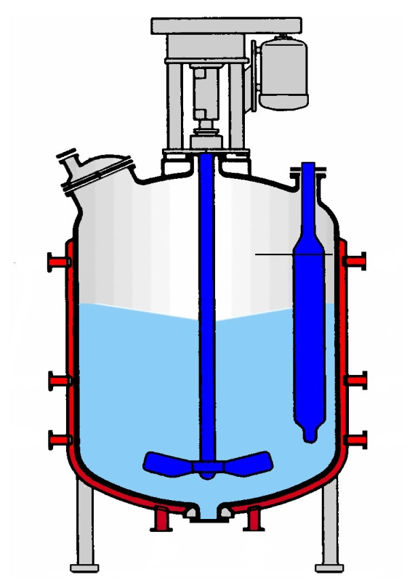
Sustainability
Typical set-up for chemical batch reactor
Steam
Brine
Cooling water
Cooling water
Brine
Condensate

Slide 9
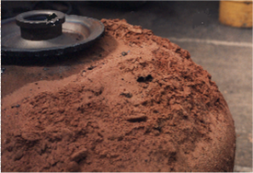
Sustainability & Efficiency
Corrosion due to humidity
Dirty cooling tower water (dust)
Chloride from warm water
Results:
Loss in heat tranfer capacities
Cost and time für cleaning
Replacment of reactor

Slide 10
Sustainability & Efficiency
No Repeatable Temperature Profiles
Temperature spots causing Thermal shock
Difficult Automation - GMP compliance
Jacket Corrosion
Limited Temperature Ranges
Long “Utility” Switchovers
Steam
Brine
Cooling water
Cooling water
Brine
Condensate

Slide 11
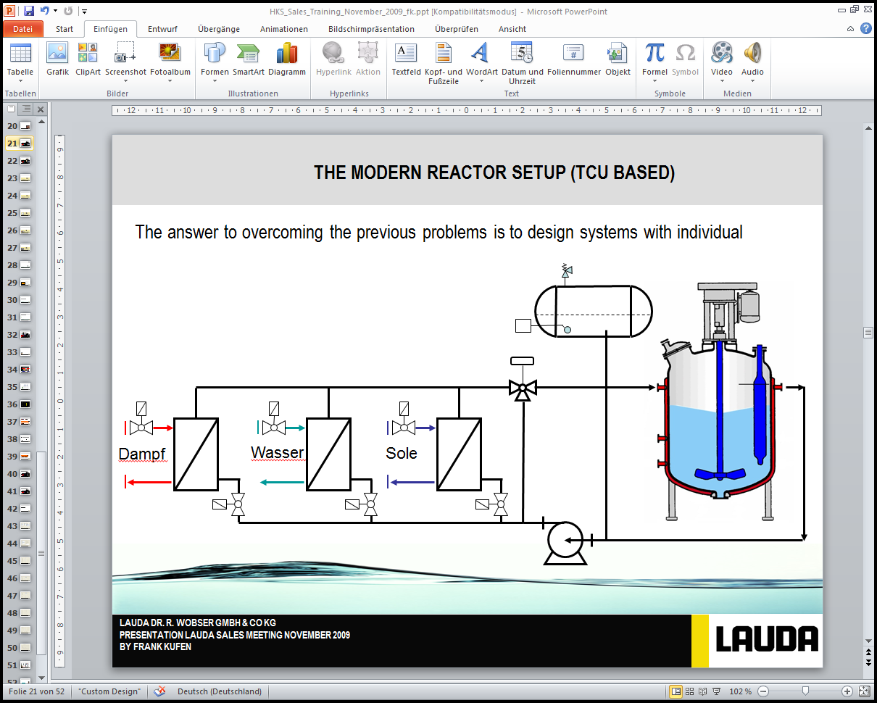
Sustainability via monofluid system
steam
water
brine
Indirect heating and cooling: Between Produkt / Consumer a heat transfer medium the so called heat carrier (liquid) circulates.
Typical set up: Pump, Heater, Cooler, Expansion Tank, Temperature controller, Consumer

Slide 12
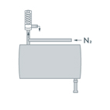
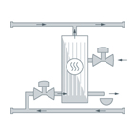
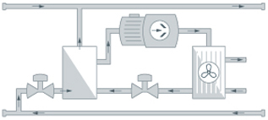
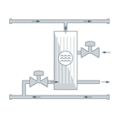
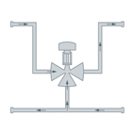
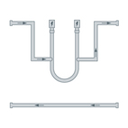
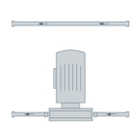
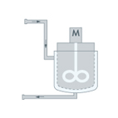
Additional electrical heating and compressor technology integrated
down to -100 °C
Up to +400 °C

Slide 13
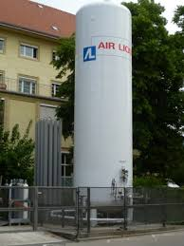
Additional liquid nitrogen cooling
down to -100 °C

Slide 14
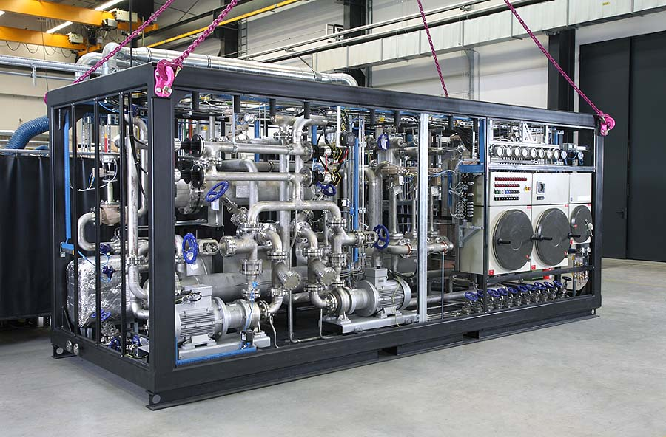

Slide 15
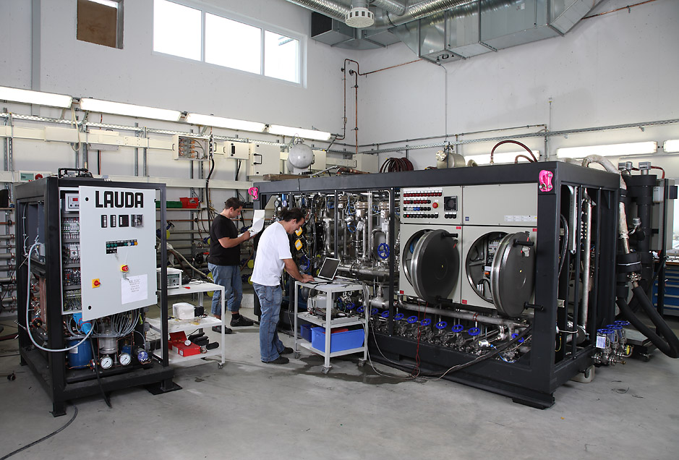
Efficiency
FAT at LAUDA
Full simulation
Availability of all media
GMP compliant documentation

Slide 16




1000 + projects and customers
Trust in world class temperature control skids

Slide 17
Thanks
Degree LAUDA Precision Pvt. Ltd.
+91 8805230098
info@degree-lauda-precision.in
Sawant Process Solutions Pvt. Ltd.
T +91 22 40166407
info@sawantsolutions.com
www.sawantsolutions.com

